Slide 1
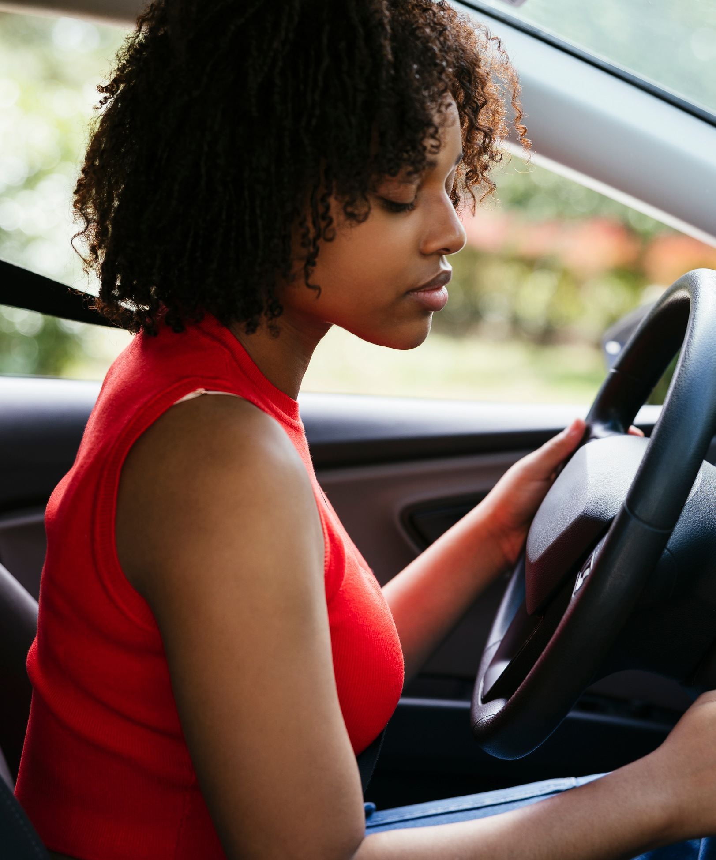
SafeNav - Ottawa
Topic: Transportation and mobility
Team Members:
-Arit Akpan
-Esin Bilgin Savkli
-Julia Saavedra
-Eduardo Manotas
Date: Dec/04/2023

Slide 2

|Problem Statement
This project delves deep into Ottawa's traffic collision data, leveraging temporal analysis to unearth patterns, bolster safety strategies, and foster a comprehensive understanding of factors impacting road incidents. By peering into the chronology of these events, the goal is to develop insights and identify high risk zones that pave the way for proactive interventions and informed decision-making in traffic safety measures in the Ottawa region.
The Ottawa region is confronted with the challenge of improving road safety and diminishing traffic collisions. While there is an abundance of data on these incidents, a more focused analysis is needed, particularly on the timing and locations of high-risk areas. Such analysis is crucial for crafting effective safety strategies and making well-informed decisions.
This project will undertake an extensive temporal examination of Ottawa's traffic collision data. The aim is to discern patterns over time and the key factors contributing to these incidents. Identifying these high-risk times and zones is essential for developing specific safety interventions and enhancing overall traffic safety in Ottawa.
Project Focus: Ottawa Traffic Collision Data Analysis
Approach: Temporal analysis of collision data
Goal: Develop insights and identify high-risk zones
Purpose: Proactive interventions and informed decision-making in traffic safety
Key Outcome: Strengthen traffic safety measures in Ottawa region
Notes:
Add the accuracy for each cluster

Slide 3
|Data Collection and Dataset Overview
Data Source and Overview:
Data Source: City Of Ottawa
Link: Data Source Link
Data Name: Traffic Collision Data
Data Validation: Rigorously validated for accuracy.
Recent update when we got data: October 20, 2023.
Temporal Range: Covers 2017 to 2022.
Size: 71,048 traffic collision observations and 28 columns
Data Integrity: No duplicates.
Data was collected in CSV format
Attributes:
Geographic details for precise location analysis.
Environmental conditions for impact assessment.
Injury data, including severity.
Identifies dangerous spots.
Categorizes initial impact type.
Challenges:
Date-Time Column Challenge
Notes:
Add Data source link

Slide 4
|Data Cleaning and Preparation
Why Power Query?
Power Query Editor enables documented and manageable data transformations.
Data Cleaning:
Identified and removed incorrectly marked latitude values (12 observations).
Addressed null values.
Checked for outliers.
Feature Engineering:
Replaced null values with zeros.
Adjusted data types to suit analysis needs.
Created DAX formulas for in-depth analysis.
Utilized measures for aggregated values in visualizations.
Refinement of Dataset:
Omitted unnecessary columns
Validated longitude and latitude
Removed unused measures for clarity and best practices.
Notes:
Add the accuracy for each cluster

Slide 5
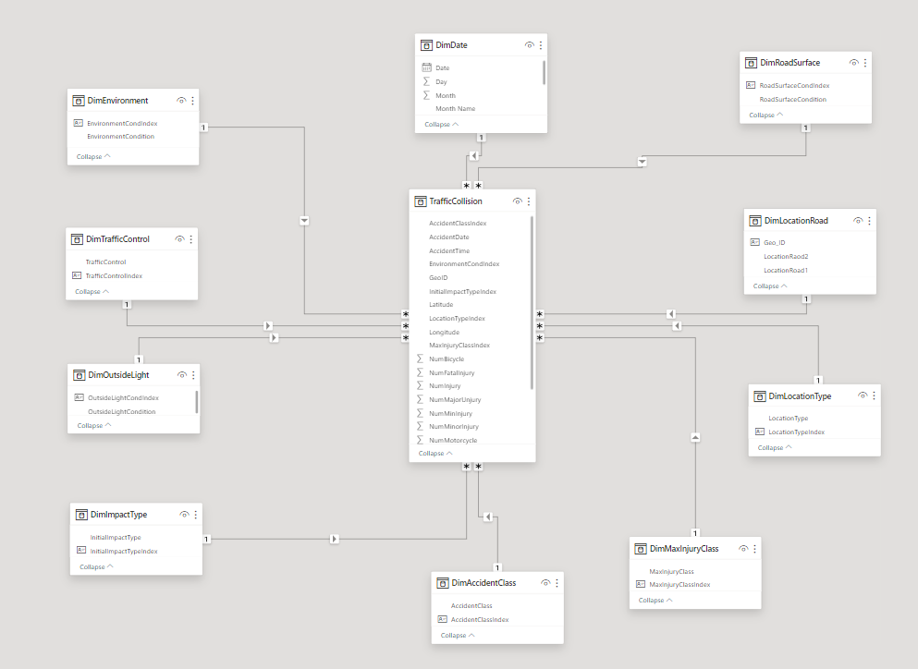
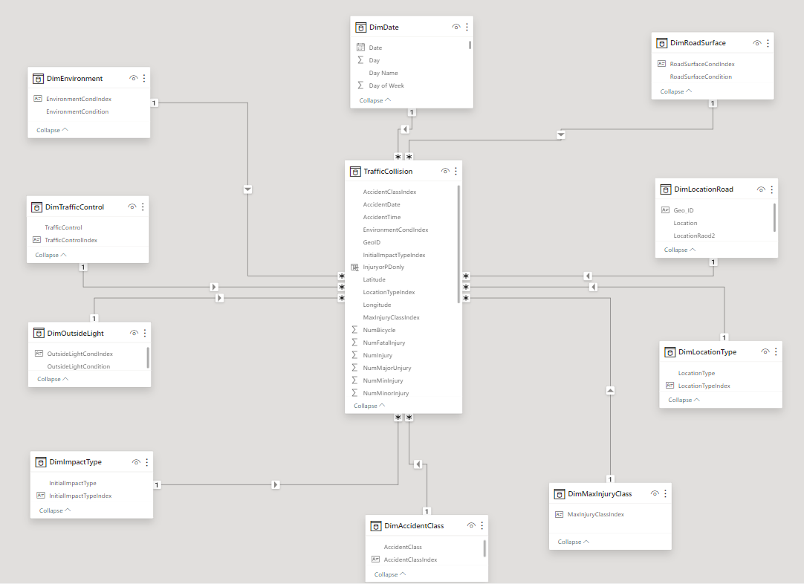
|Data Modelling
Tools and data model
Power Query Editor: Chosen for data processing and visualization capabilities.
Star Schema Development: Chose a star schema for query performance and data relationship clarity.
Challenges Faced During Data Modelling:
Data Splitting: Difficulty in splitting concatenated data such as 'RD1 @ RD2' into distinct, indexed entries for analysis.
Notes:
Add the accuracy for each cluster

Slide 6
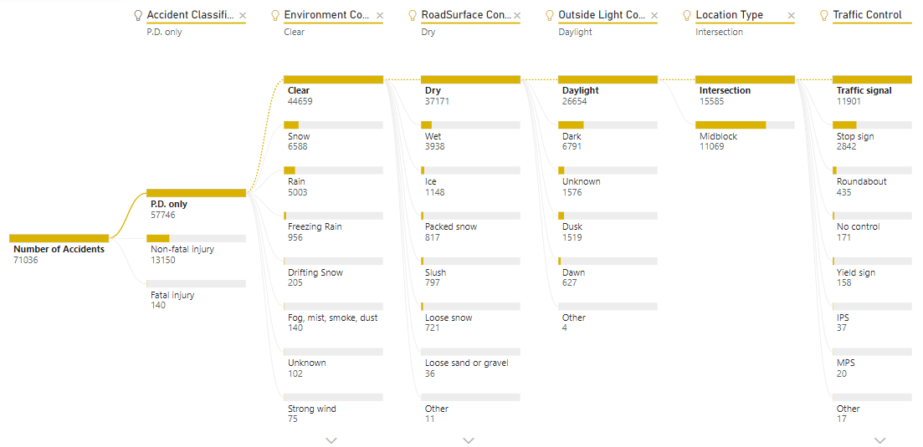
|Data Analysis
Accident Timing:
The accident in question seems to have occurred during periods where traffic signals are installed, and stop signs are in place.
Light and Road Surface Conditions:
Outside light conditions are mostly daylight.
The road surface is dry.
Environmental conditions are clear
Accident Hotspots:
Majority of accidents tend to happen at intersections.

Slide 7
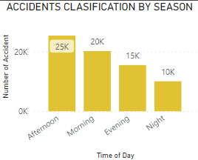
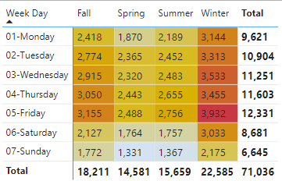
|Data Analysis
Time of Day Analysis:
The number of traffic accidents appears to peak in the afternoon.
Seasonal Impact:
The winter season exhibits the highest count of accidents compared to other seasons.
Day-wise Distribution:
Majority of accidents occur on Fridays
Thursdays follow closely in terms of accident frequency
Note:
Winter – Dec., Jan., Feb.
Afternoon – 12 – 5pm

Slide 8
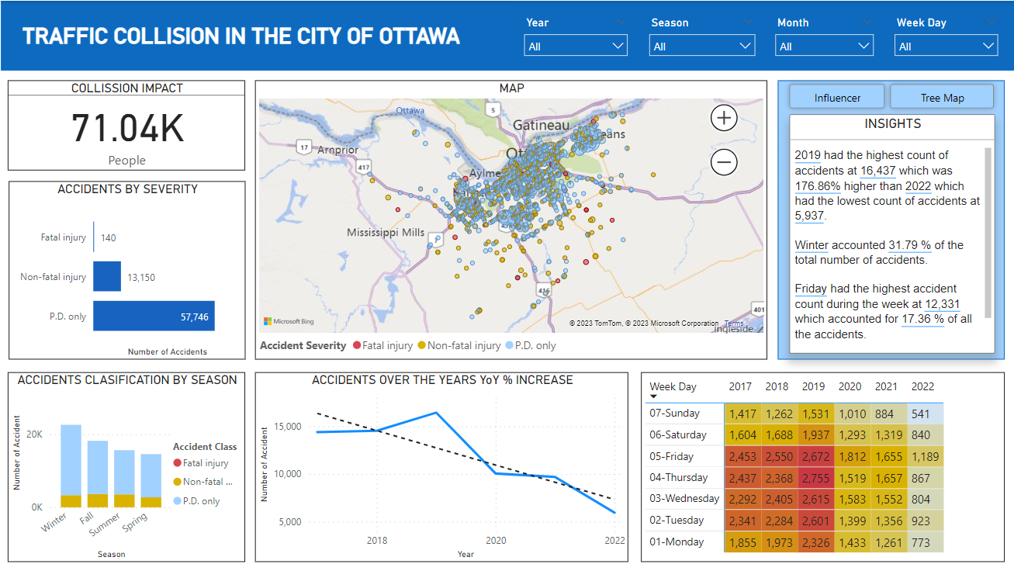
|Data Visualization & Interactivity

Slide 9
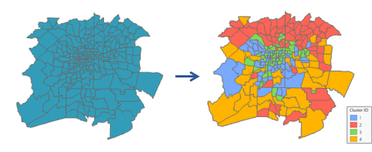
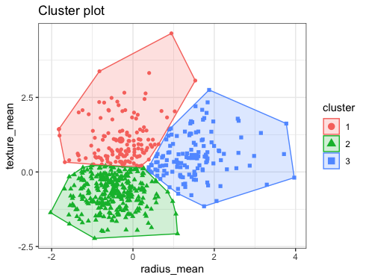
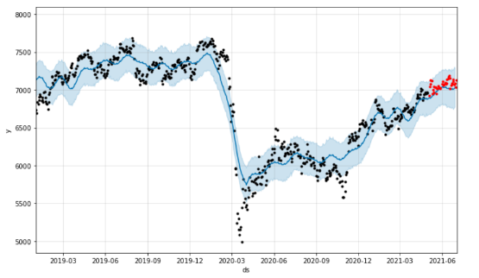
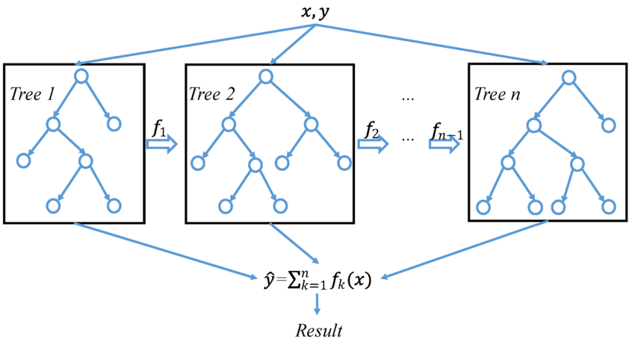
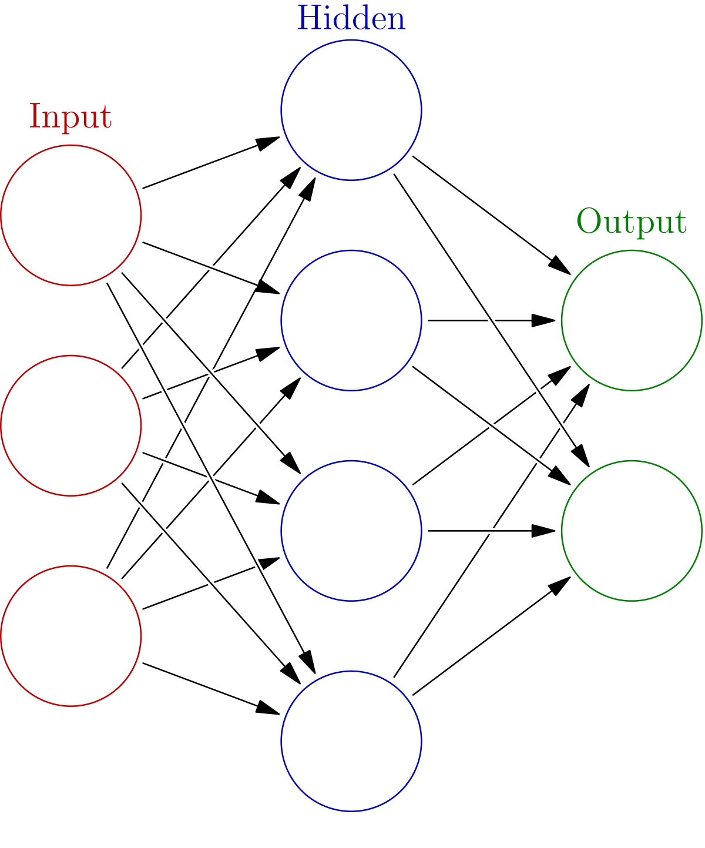
|Modeling
Business Questions
Machine learning approach
1
Cluster Ottawa region by risk severity
Outputs
Model
Features
Outputs
Model
Features
Geospatial aggregation and risk clustering, Enhancing resource allocation for effective safety measures.
- Geo Location
- Number of Accidents
- Number of Injuries
- Grid
- Cluster
-Geo Pandas + K Means
2
Weekly Accident Prediction
Features
Outputs
Model
Features
Outputs
Model
- Week#
- Season
- Holidays
- Covid Peaks
Binary
Classification
(1/0)
-Prophet
-XgBoost
-Deep NN
Facilitate proactive planning, reducing response time and improving safety awareness.
Notes:
Add the accuracy for each cluster

Slide 10
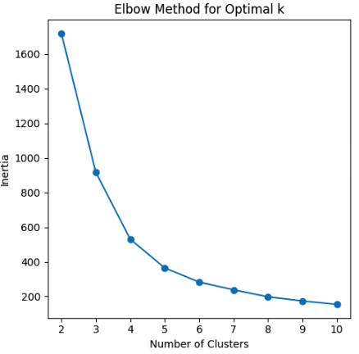
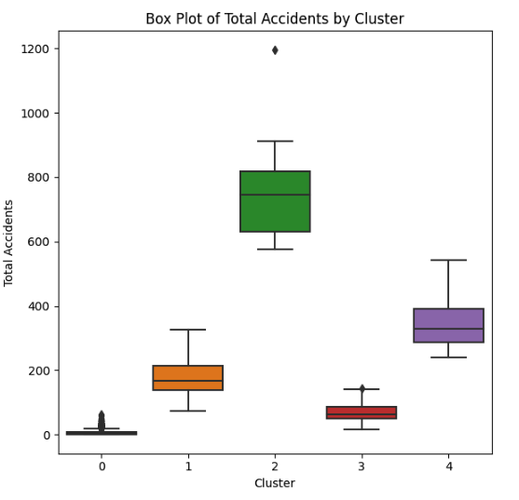
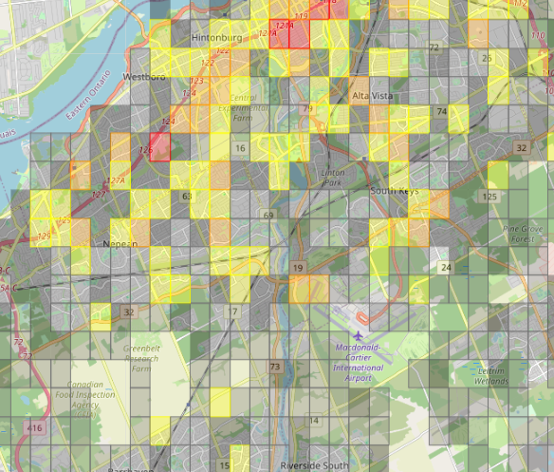
|Geo Clustering
1
2
3
Highlights
- It appears that the distribution of geo clusters aligns with the spatial arrangement of grids
- Critical, High and Moderate clusters with 6% of the Grids, represent 60% of total accidents.
K-Means
Find Optimal K for Risk clustering using elbow methodology
K= 5
K-Means
Inspect clustering result and distribution
GeoPandas
Divide the city in small grids of 800 mts to aggregate accidents ‘Locations’
Cluster | # of Grid | % Grid | Avg Total Accidents | % Total Accidents
Critical | 9 | 0,4% | 770,1 | 9,8%
High | 38 | 1,6% | 341,8 | 18,3%
Moderate | 118 | 4,9% | 176,8 | 29,4%
Low | 252 | 10,4% | 68,2 | 24,2%
Rare | 1996 | 82,7% | 6,6 | 18,4%
Grand Total | 2413 | 100,0% | 29,4 | 100,0%
Rare
Moderate
Critical
Low
High
Clusters

Slide 11
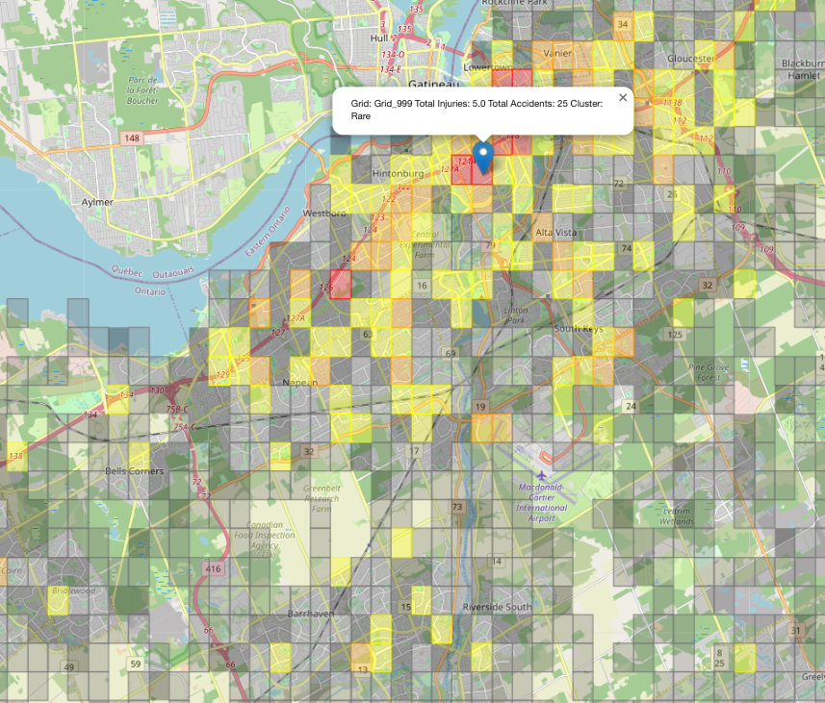
|Forecast and outputs
Model Results
Visual Mapping
Highlights
Model
Model
Model
- In general models don’t perform very well, next steps include new features from date column, environmental variables, Location features (Parks , Budlings, etc.)
- Neural networks outputs are the one used for the final recommendation , the model outperform for High and Critical clusters.
Model
Avg Precision
Avg
Accuracy
Grid: 128
Cluster: Critical
-XgBoost
61%
64%
-Neural
Networks
67%
63%
-Prophet
62%
61%
Notes:
Add the accuracy for each cluster

Slide 12
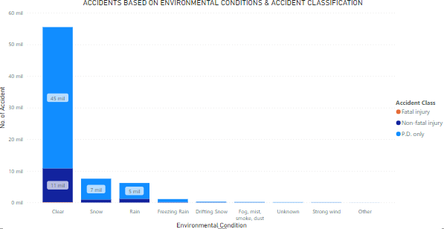
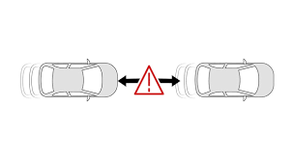
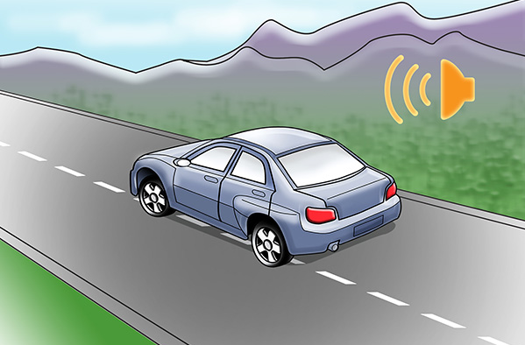
|Recommendations - Environment
88.5%
of total accidents between clear and snow
Encourage regular vehicle maintenance, especially checking brakes, lights and tires.
Offer incentives for drivers who have a record of driving safely in adverse weather conditions
Promote vehicle safety technologies, such as automatic braking systems and lane departure alerts.

Slide 13
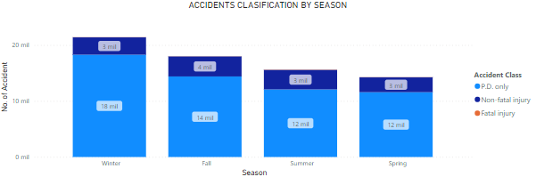


|Recommendations – Season
55.4%
of total accidents between winter and fall
Provide information about the importance of winter tires.
Use technology to provide real-time updates on road status and weather conditions.
Provide specific training for drivers of emergency vehicles operating in winter conditions.

Slide 14


|Recommendations – Day of week
Increase police presence these days in identified high-risk areas.
Strict issuing of tickets to drivers who do not comply with safe driving rules.
Encourage safe transportation practices for employees, such as flexible schedules or ride-sharing services.

